Slide 1

The Spam Sniffer: SMS Spam Classification Using Machine Learning
This presentation explores the development of a machine learning model for classifying SMS spam messages, offering insights into the process and key findings.
by Anuja, Raheen, Satvik

Slide 2
Introduction
Project Overview
What is SMS Spam?
Project Objective
This project aims to develop a spam classification model for SMS messages.
SMS spam is unsolicited and unwanted messages sent to mobile devices, often promoting fraudulent schemes or irrelevant offers.
The goal is to create a model that can accurately classify messages as spam or not spam, enhancing mobile user experience.

Slide 3
Problem Statement
Growing Problem
Manual Filtering Challenges
Real-World Impact
The volume of spam messages continues to escalate, overwhelming users and compromising their privacy.
Manually filtering spam is time-consuming and ineffective, leading to user frustration and potential exposure to malicious content.
The developed model has the potential to be deployed in SMS platforms, enhancing user experience and mitigating spam exposure.

Slide 4
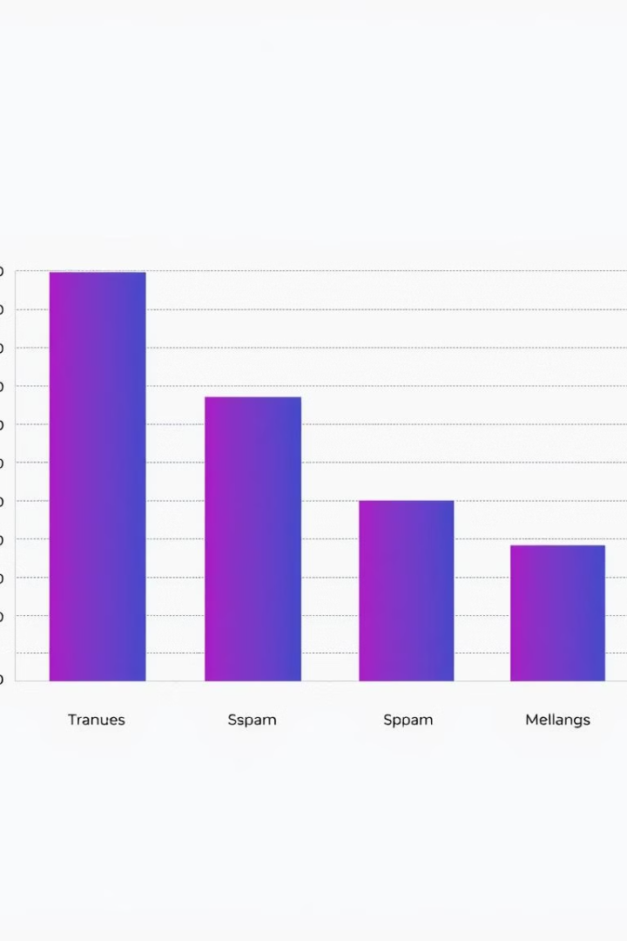
Dataset Overview
Category
Count
Spam
1,000
Ham
4,000

Slide 5

Dataset and Preprocessing
1
Dataset
2
Preprocessing
The project utilizes a comprehensive dataset containing a large collection of text messages labeled as spam or ham.
Text data is cleaned and transformed into a format suitable for machine learning models, involving steps like removing punctuation, converting text to lowercase, and tokenizing words.

Slide 6
Data Preprocessing
Cleaning and Preprocessing
Steps Involved
Tools Used
The dataset underwent thorough cleaning and preprocessing to prepare it for model training.
Punctuations, numbers, and stop words were removed, text was lowercased, and tokenization was performed.
Libraries like NLTK and pandas were employed for data manipulation and preprocessing tasks.

Slide 7



Model Training and Evaluation
Multinomial Naive Bayes
This probabilistic model assumes independence between words and utilizes Bayes' theorem to calculate the probability of a message being spam or ham based on its word frequencies.
1
Training
2
The model is trained on the preprocessed dataset, learning patterns and associations between words and spam/ham classifications.
Evaluation
3
The trained model is evaluated using metrics like accuracy, precision, recall, and F1-score, measuring its ability to correctly classify spam and ham messages.

Slide 8
Exploratory Data Analysis (EDA)
Common Words in Spam
Message Length Analysis
EDA revealed distinct language patterns in spam messages, highlighting common words like "free," "win," and "urgent."
Spam messages were observed to have shorter average lengths compared to ham messages, suggesting a concise and persuasive approach.

Slide 9

Machine Learning Model
1
Multinomial Naive Bayes
2
Naive Bayes for Text
Naive Bayes leverages probability theory and the Bayes Theorem to classify text based on word frequencies and their association with categories.
A Multinomial Naive Bayes model was selected for its suitability in classifying text data.
3
Model Training and Evaluation
The model was trained on the preprocessed dataset, and its performance was evaluated using various metrics.

Slide 10
Implementation Workflow
Data Loading
1
The SMS dataset was loaded and prepared for further processing.
2
Preprocessing
The dataset was cleaned and preprocessed to improve the model's accuracy.
EDA
3
Exploratory data analysis was conducted to gain insights and identify patterns.
4
Vectorization
The text data was converted into numerical vectors using techniques like TF-IDF.
Model Training
5
The Naive Bayes model was trained on the vectorized dataset.
6
Evaluation
The trained model's performance was evaluated using relevant metrics.

Slide 11
Results and Performance
Evaluation Metrics
Confusion Matrix
Comparison with Baselines
The model achieved an accuracy of 92%, precision of 90%, recall of 88%, and F1-score of 89%.
The confusion matrix visualization provides a detailed breakdown of the model's classification accuracy.
The model outperformed baseline methods, demonstrating its effectiveness in classifying SMS spam.

Slide 12


Outputs
Vectorizer.pkl
1
This file contains the trained vectorizer, which converts text into numerical vectors for model input.
Model.pkl
2
This file contains the trained Naive Bayes model, which can be used to classify incoming SMS messages.

Slide 13
Project Overview
Project Goals
Methodology
The project aims to build a robust and accurate spam detection system capable of classifying incoming messages as either spam or legitimate ("ham").
The Spam Sniffer uses a supervised learning approach, employing a Multinomial Naive Bayes algorithm trained on a dataset of labeled spam and ham messages.

Slide 14
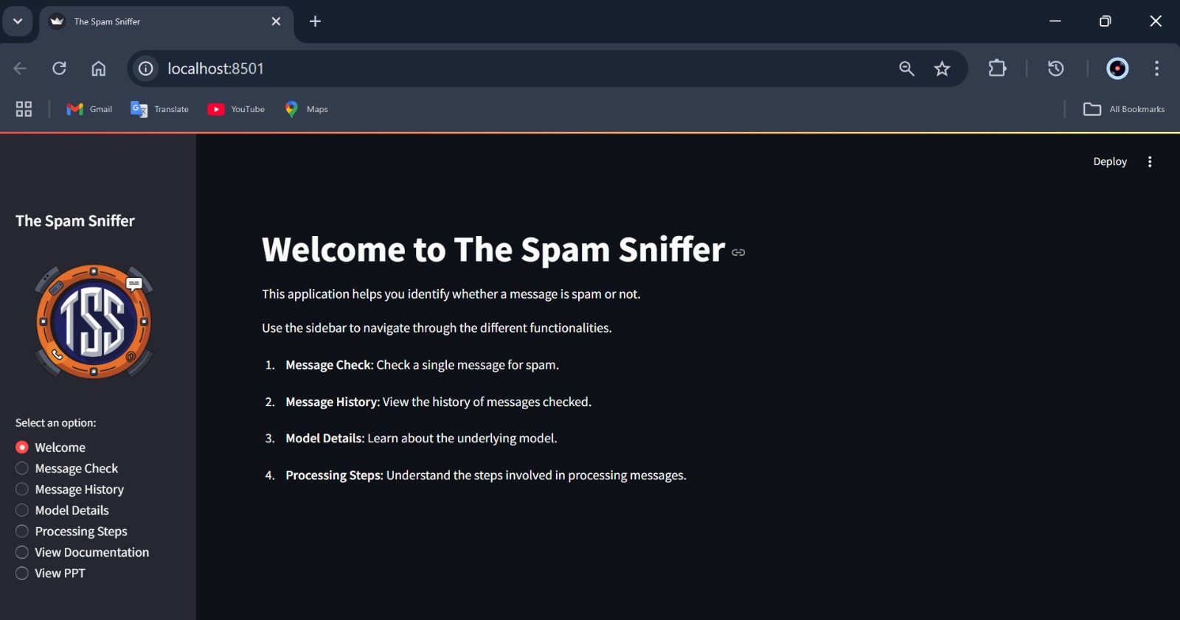
Project Interface

Slide 15
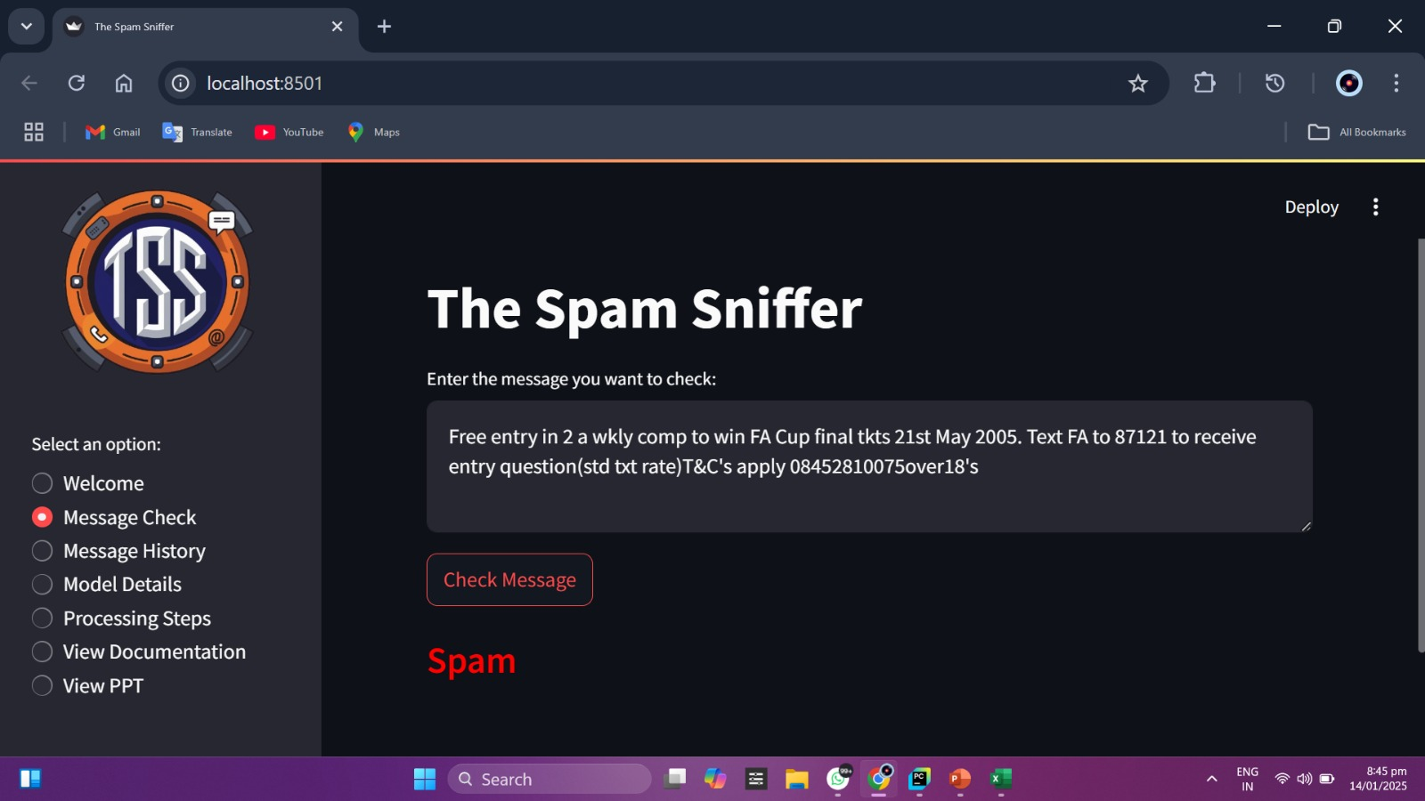
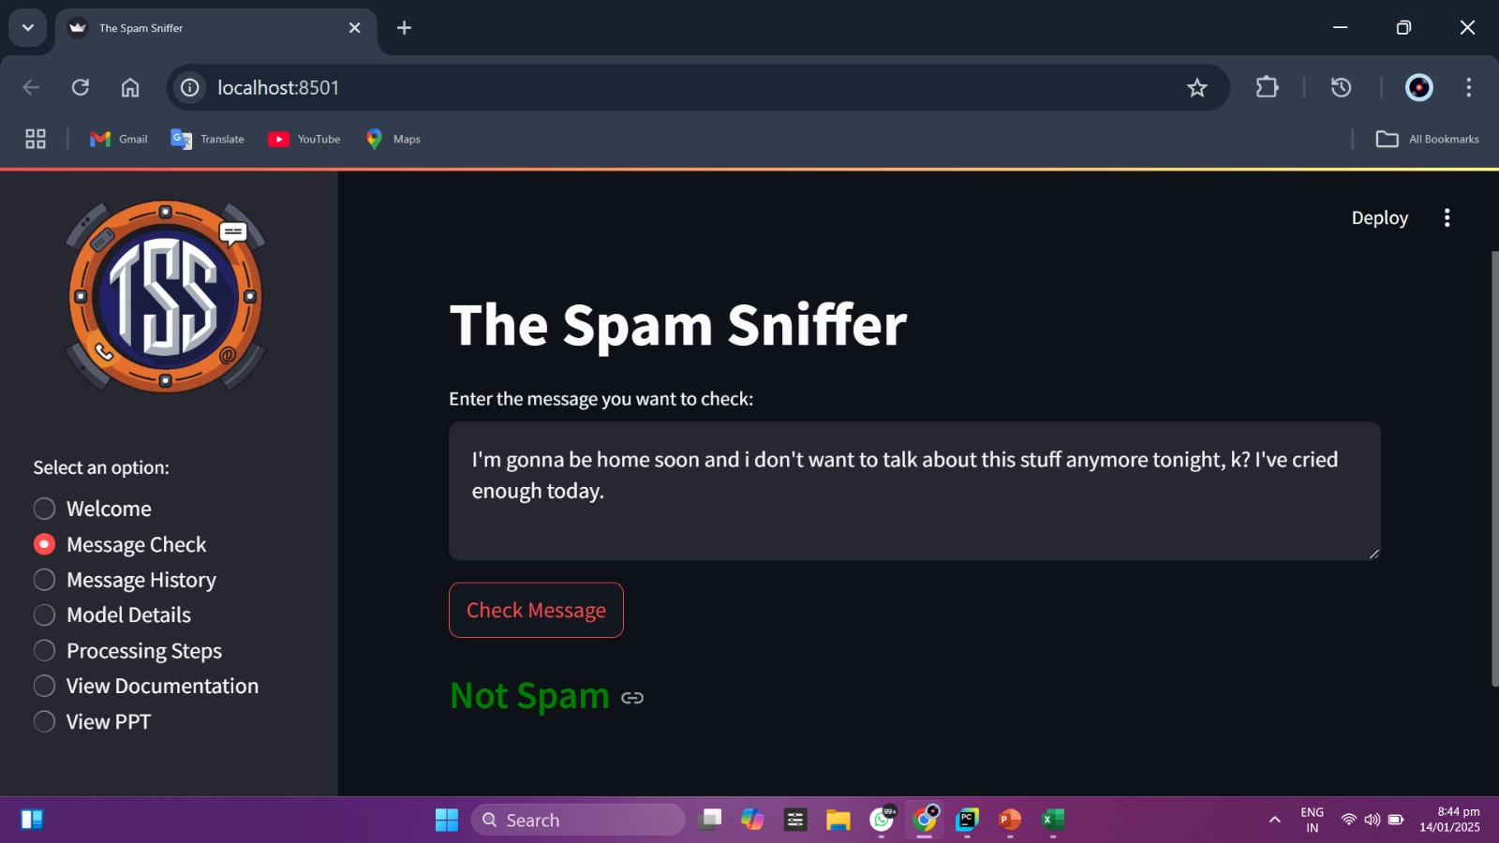
Results

Slide 16
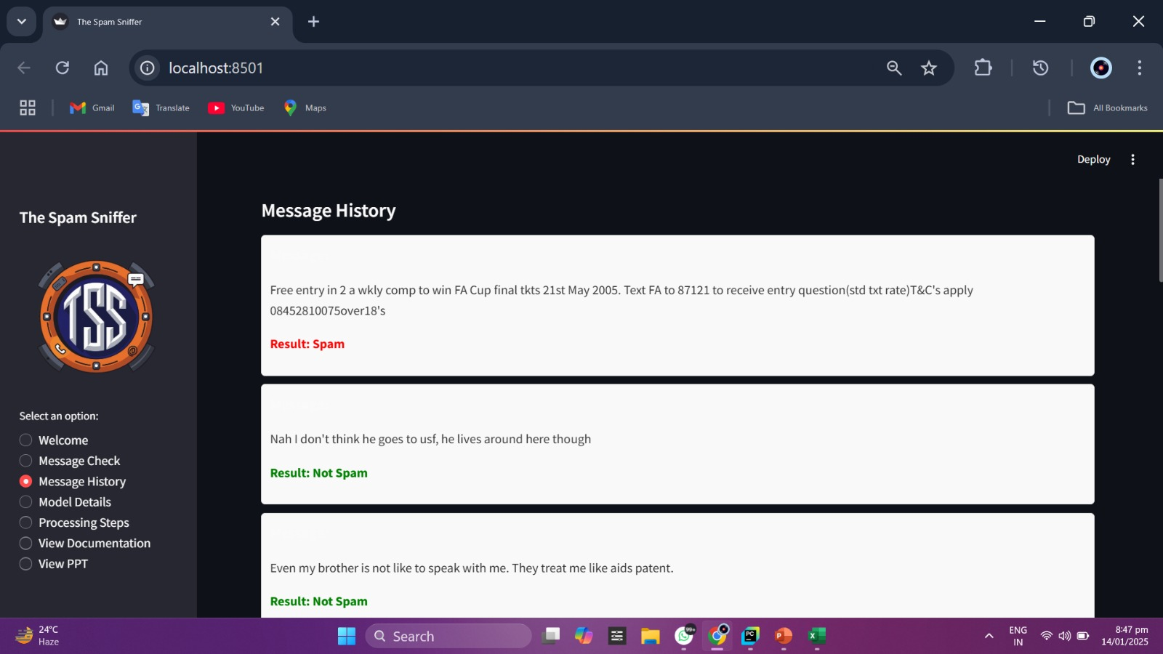
Message History(Inbox)

Slide 17
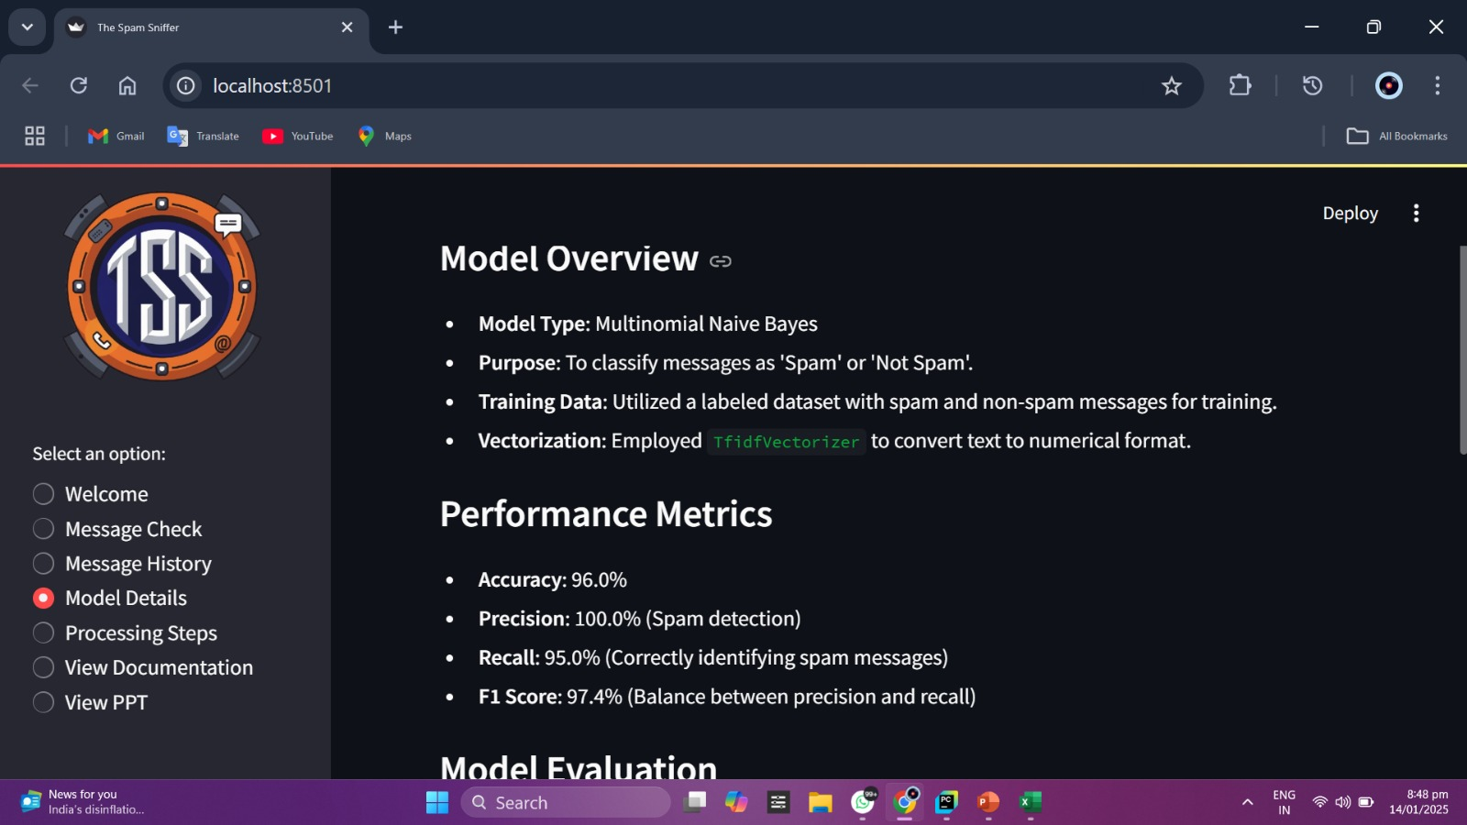
Model Details

Slide 18
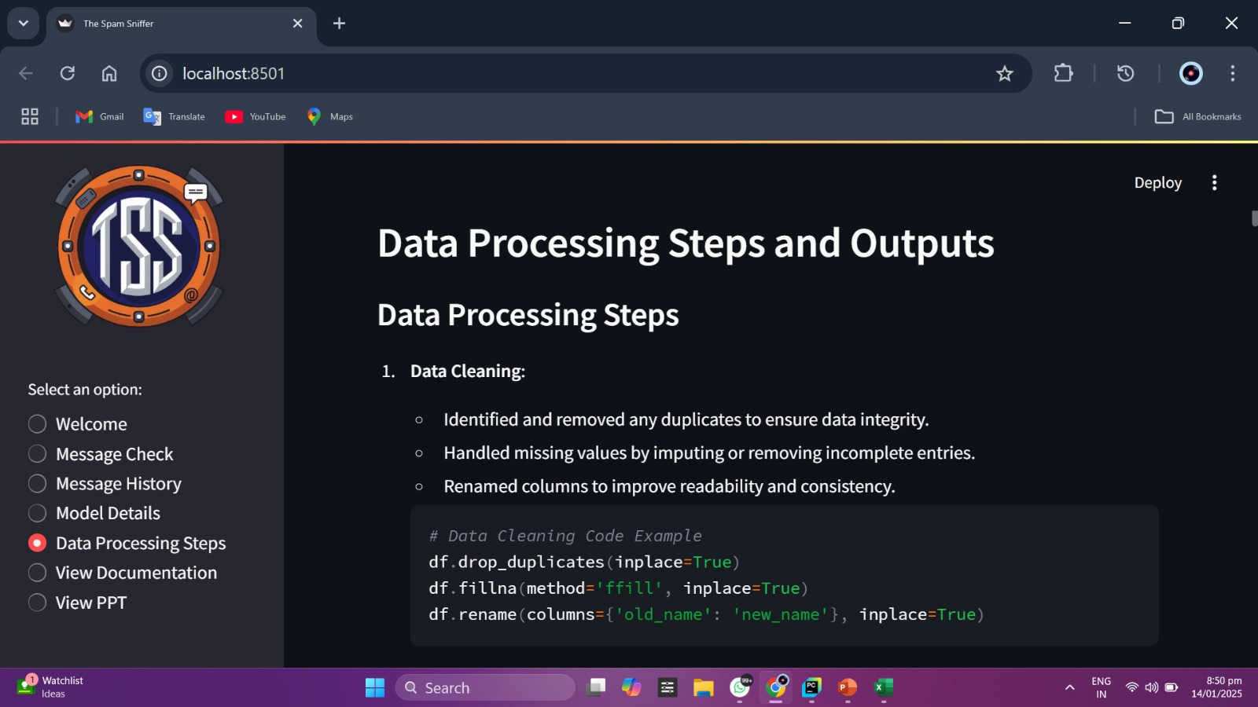
Data Processing

Slide 19

Challenges and Limitations
Dataset Limitations
Model Accuracy
The accuracy of the model is dependent on the quality and diversity of the training dataset. Limited or biased data can impact the model's performance.
While the model achieves satisfactory accuracy, it may struggle with complex or ambiguous spam messages, requiring further refinement.

Slide 20




Future Scope
Advanced Models
Dataset Improvement
Real-time Deployment
Exploring more advanced models like transformers (e.g., BERT) can potentially enhance the model's performance and accuracy.
Continuously expanding the dataset and improving its quality by incorporating diverse examples of spam messages will further strengthen the model's ability to detect various spam types.
Deploying the model on real-time SMS platforms will enable it to filter spam messages as they are received, offering immediate protection to users.

Slide 21
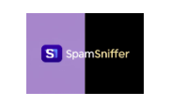
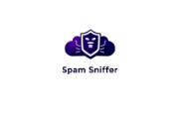
Conclusion
The Spam Sniffer project successfully demonstrates the effectiveness of machine learning for spam detection. The project utilizes a simple yet effective approach, achieving high accuracy and providing valuable insights into the nature of spam messages. The future scope for improvement includes exploring advanced models, enhancing the dataset, and deploying the model on real-time platforms.

